Slide 1
Motion Sensor using PIR sensor.

Slide 2
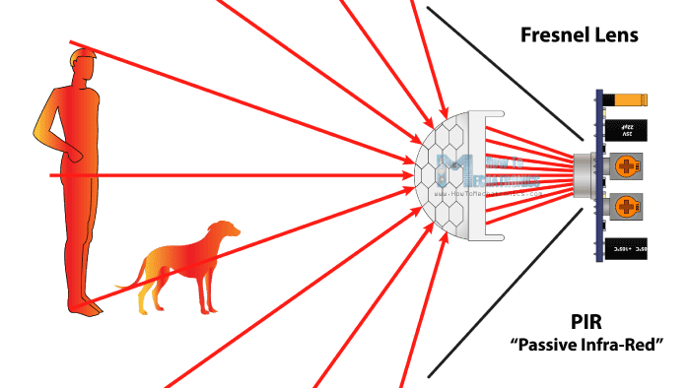
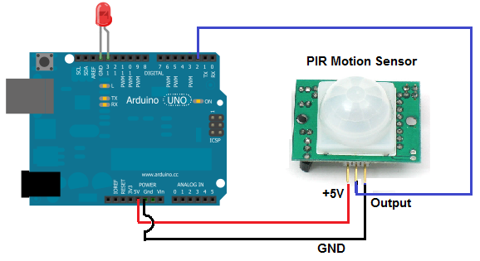

Slide 3
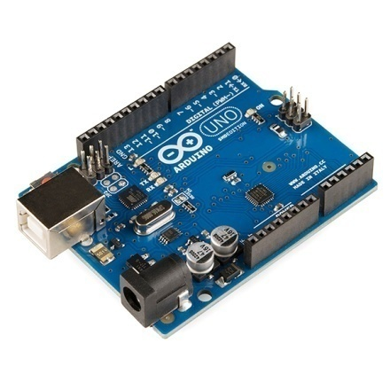
Components used are:
Arduino UNO
Arduino is an open-source electronics platform based on easy-to-use hardware and software. Arduino boards are able to read inputs - light on a sensor, a finger on a button. You can tell your board what to do by sending a set of instructions to the microcontroller on the board. To do so you use the Arduino programming language (based on Wiring), and the Arduino
Software (IDE) based on Processing.

Slide 4
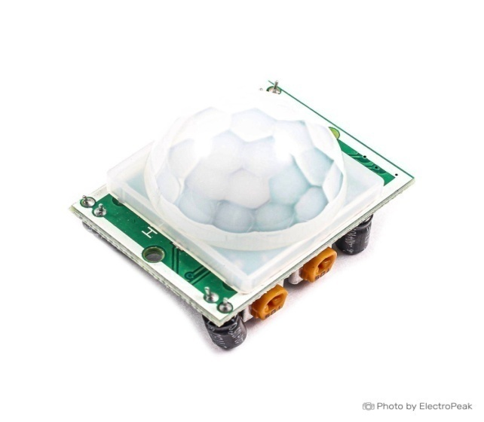
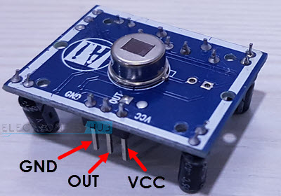
PIR Sensor
1. PIR sensor detects a human being moving around within approximately 10m from the sensor. This is an average value, as the actual detection range is between 5m and 12m.PIR are fundamentally made of a pyro electric sensor, which can detect levels of infrared radiation.
2. PIR sensors are incredible, they are flat control and minimal effort, have a wide lens range, and are simple to interface with.

Slide 5
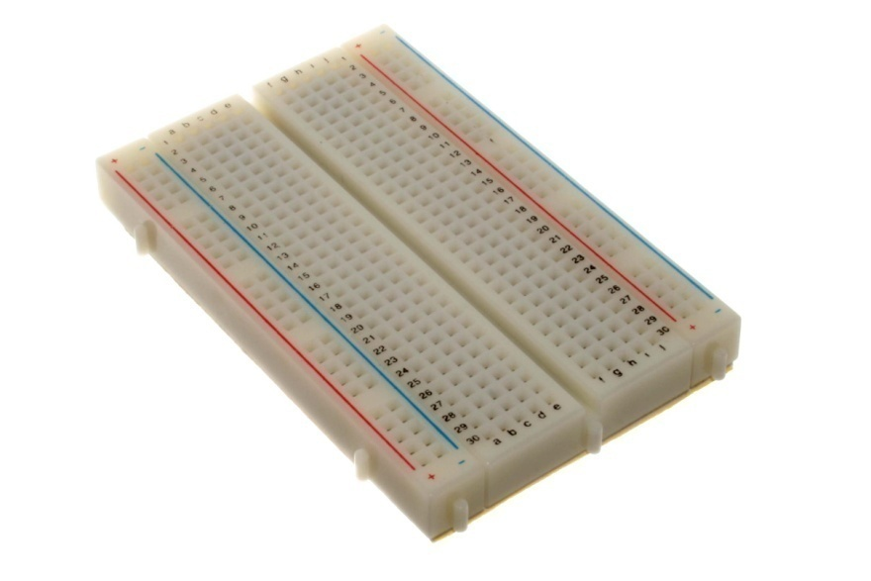
Breadboard
A breadboard is a solder less device for temporary prototype with electronics and test circuit designs. Most electronic components in electronic circuits can be interconnected by inserting their leads or terminals into the holes and then making connections through wires where appropriate.

Slide 6
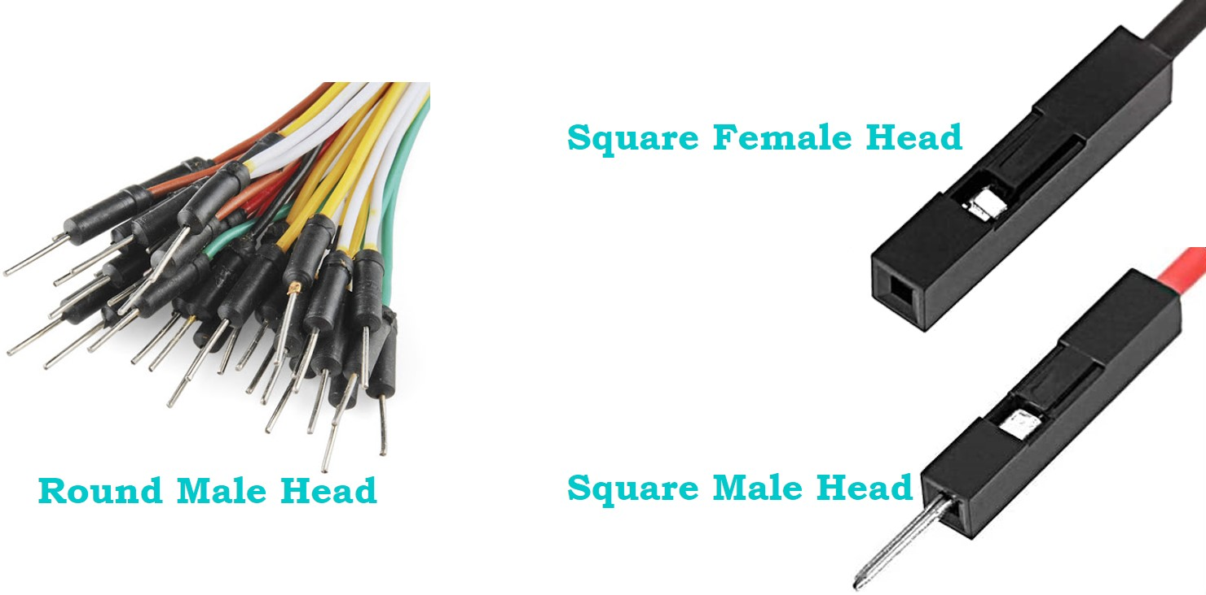
Jumper wire
Jumper wires are used for making connections between items on breadboard and Arduino's header pins.
Red Bulb: It glow when motion is detected.

Slide 7
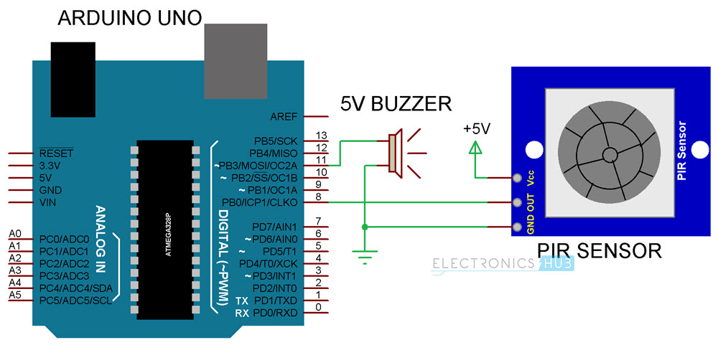
Circuit Diagram:

Slide 8
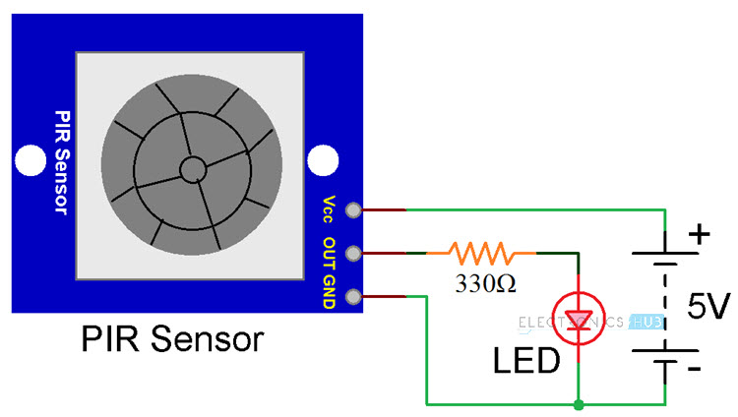
Circuit Design:
The design of the PIR Motion Sensor using Arduino is very simple. The PIR Sensor Module has three pins: VCC, Digital Out and GND. Connect VCC and GND to +5V and GND respectively. Then connect the Digital Out Pin of the PIR sensor to the digital I/O pin 8 of Arduino.
As we need to indicate the detection of motion by the sensor, connect a red light to Pin 11 of the Arduino.

Slide 9
How does PIR Sensor works?
PIR Sensors are complicated than most other sensors. PIR Motion Sensor may seem simple when implemented as all we need to do is check for a HIGH signal on the Digital Out Pin of the Sensor whenever motion is detected.
But, internally, there is a lot going on and the input and output of the sensor are dependent on several variables.
The actual PIR Sensor i.e. the one which is covered with a lens, consists of two slots and both these slots are made up of IR Sensitive materials. Under normal condition where there is no movement in front of the sensor, both the slots in the Sensor detect same amount of infrared radiation.
When there is movement in front of the sensor, like a human or a cat, their radiation is interpreted by one of the slots first and the differential output between the two slots becomes positive.
As the person moves away, the second slot detects the radiation and the differential output will become negative. Based these output pulses, a motion is detected.

Slide 10
Working of Arduino’s PIR sensor.
The working of this project is very simple. When the system is powered on, the Arduino waits for the PIR Sensor to be calibrated. The calibration period is set to 10 seconds and during this time, there should be no movements in front of the PIR Sensor.
After the calibration, the PIR Sensor will be ready to detect any movement in front of it. If the PIR Sensor detects any movements, its Digital Out pin, which is connected to Pin 8 of Arduino will become HIGH.
Arduino will detect this HIGH Signal and red light glows.

Slide 11
Applications:
Arduino PIR Sensor Interface can be implemented in a wide range of project but the important one is the Motion Detection System.
A variety of Home Security Systems can be implemented using Arduino and PIR Sensor.
They are also used in lift lobbies, door opening, etc.

Slide 12
Credits:
Deep Salunkhe.
Omkar Patil.
Premanshu choudary.
Shiv Rakh.
Mayur Hile.

Slide 13
Thank You!!

